Slide 1
Distributed Knowledge Graph Querying on Edge, Fog and Cloud
DS 256 – Project Proposal
Shriram R
09-Dec-18

Slide 2
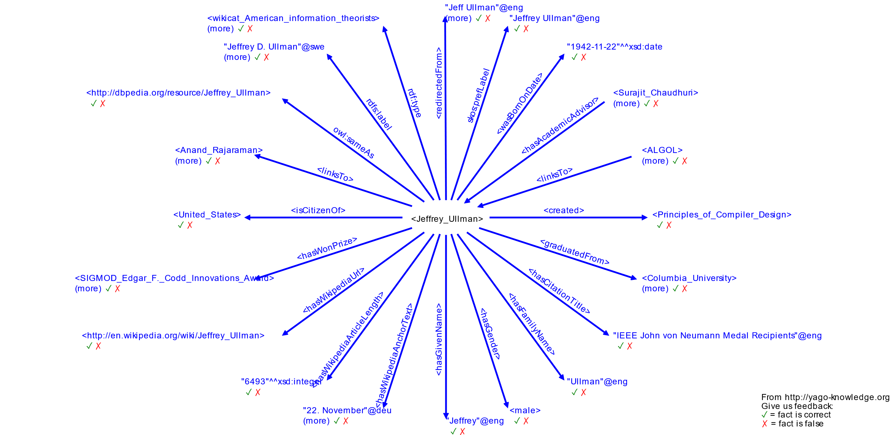
Knowledge Graph – YAGO [1]

Slide 3
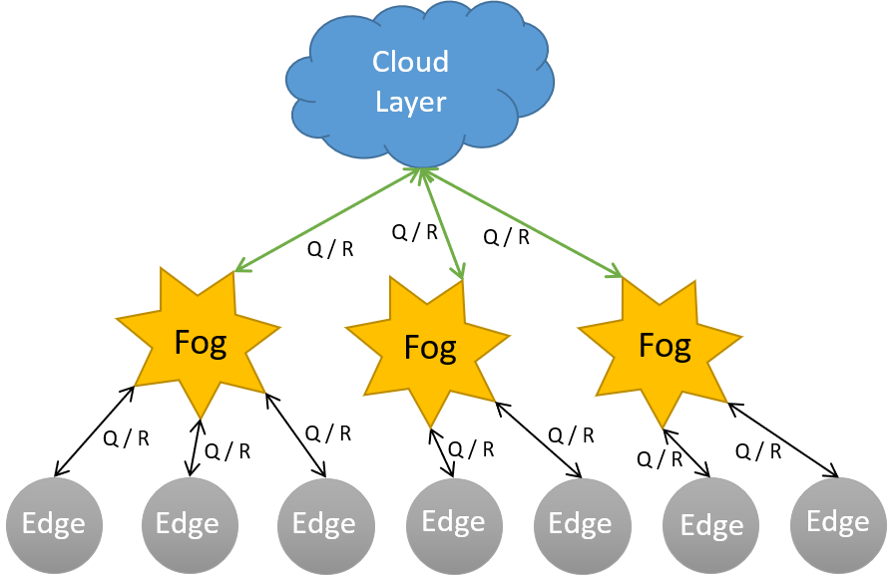
Motivation
Knowledge Graphs are huge!
Graph mining problems are computationally hard
IoT – Heterogenous Structure
Different Compute, Storage & Network Capacity
Needs lightweight and low latency solution

Slide 4
Key Contributions
Graph Partitioning
Partition graph across edge devices and cloud
Query Partitioning
Partition query into local and global query
Query Caching
Devise caching mechanism in fog devices for global queries
Graph Indexing
Indexing for local graphs in edge devices for different query types

Slide 5
Related Work
Graph Processing
Pregel [2]
Giraph [3]
GraphX [4]
Trinity [5]
GoDB [11]
Quegel [13]
Graph Caching
GC [6]
Graph Indexing
C-Tree [7]
Views [8]
FERRARI [9]
GraphS [10]

Slide 6
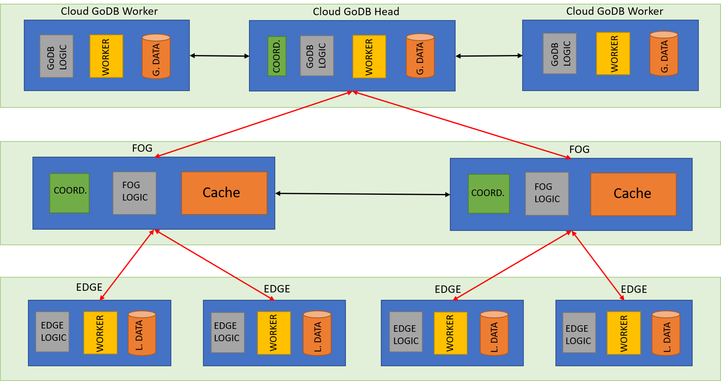
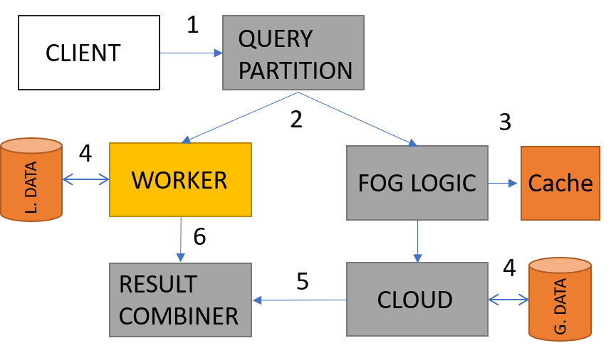
Problem Approach
Logical Flow
Architecture Overview

Slide 7
Experiment Proposal
Microsoft Azure
GoDB [11] on D4 VMs
VIoLET [14] for IoT deployment
3 Fogs
20 Edges per Fog
Dataset
YAGO [1]
NELL [15]
Experiments
Query Partitioning
Query Caching
Graph Indexing
Baseline – Cloud Only Graph Engine
Local and Global Execution Times are Measured
Random queries of all Types

Slide 8
Questions?

Slide 9
References
[1] F. M. Suchanek, G. Kasneci, and G. Weikum, “Yago: A core of semantic knowledge,” in Proceedings of the 16th International Conference on World Wide Web, ser. WWW ’07. New York, NY, USA: ACM, 2007, pp. 697–706. [Online].
[2] G. Malewicz, M. H. Austern, A. J. Bik, J. C. Dehnert, I. Horn, N. Leiser, and G. Czajkowski, “Pregel: A system for large-scale graph processing,” in Proceedings of the 2010 ACM SIGMOD International Conference on Management of Data, ser. SIGMOD ’10. New York, NY, USA: ACM, 2010, pp. 135–146.
[3] A. Ching, S. Edunov, M. Kabiljo, D. Logothetis, and S. Muthukrishnan, “One trillion edges: Graph processing at facebook-scale,” Proc. VLDB Endow., vol. 8, no. 12, pp. 1804–1815, Aug. 2015.
[4] R. S. Xin, J. E. Gonzalez, M. J. Franklin, and I. Stoica, “Graphx: A resilient distributed graph system on spark,” in First International Workshop on Graph Data Management Experiences and Systems, ser. GRADES ’13. New York, NY, USA: ACM, 2013, pp. 2:1–2:6.
[5] B. Shao, H. Wang, and Y. Li, “Trinity: A distributed graph engine on a memory cloud,” in Proceedings of the 2013 ACM SIGMOD International Conference on Management of Data, ser. SIGMOD ’13. New York, NY, USA: ACM, 2013, pp. 505–516.
[6] J. Wang, N. Ntarmos, and P. Triantafillou, “Graphcache: A caching system for graph queries,” pp. 13–24, March 2017.
[7] H. He and A. K. Singh, “Closure-tree: An index structure for graph queries,” in 22nd International Conference on Data Engineering (ICDE’06), April 2006, pp. 38–38.
[8] W. Fan, X.Wang, and Y.Wu, “Answering graph pattern queries using views,” in 2014 IEEE 30th International Conference on Data Engineering, March 2014, pp. 184–195.
[9] S. Seufert, A. Anand, S. Bedathur, and G. Weikum, “Ferrari: Flexible and efficient reachability range assignment for graph indexing,” in 2013 IEEE 29th International Conference on Data Engineering (ICDE), April 2013, pp. 1009–1020.
[10] X. Qiu, W. Cen, Z. Qian, Y. Peng, Y. Zhang, X. Lin, and J. Zhou, “Real-time constrained cycle detection in large dynamic graphs,” Proc. VLDB Endow., vol. 11, no. 12, pp. 1876–1888, Aug. 2018.
[11] N. Jamadagni and Y. Simmhan, “Godb: From batch processing to distributed querying over property graphs,” in IEEE CCGRID, 2016.
[12] Y. Simmhan, A. Kumbhare, C. Wickramaarachchi, S. Nagarkar, S. Ravi, C. Raghavendra, and V. Prasanna, “Goffish: A subgraph centric framework for large-scale graph analytics,” in Euro-Par 2014 Parallel Processing, F. Silva, I. Dutra, and V. Santos Costa, Eds. Cham: Springer International Publishing, 2014, pp. 451–462.
[13] D. Yan, J. Cheng, M. T. Özsu, F. Yang, Y. Lu, J. C. S. Lui, Q. Zhang, and W. Ng, “A general-purpose query-centric framework for querying big graphs,” Proc. VLDB Endow., vol. 9, no. 7, pp. 564–575, Mar. 2016.
[14] S. Badiger, S. Baheti, and Y. Simmhan, “Violet: A largescale virtual environment for internet of things,” CoRR, vol. abs/1806.06032, 2018.
[15] T. Mitchell, W. Cohen, E. Hruschka, P. Talukdar, B. Yang, J. Betteridge, A. Carlson, B. Dalvi, M. Gardner, B. Kisiel, J. Krishnamurthy, N. Lao, K. Mazaitis, T. Mohamed, N. Nakashole, E. Platanios, A. Ritter, M. Samadi, B. Settles, R. Wang, D. Wijaya, A. Gupta, X. Chen, A. Saparov, M. Greaves, and J. Welling, “Never-ending learning,” Commun. ACM, vol. 61, no. 5, pp. 103–115, Apr. 2018.

